Slide 1




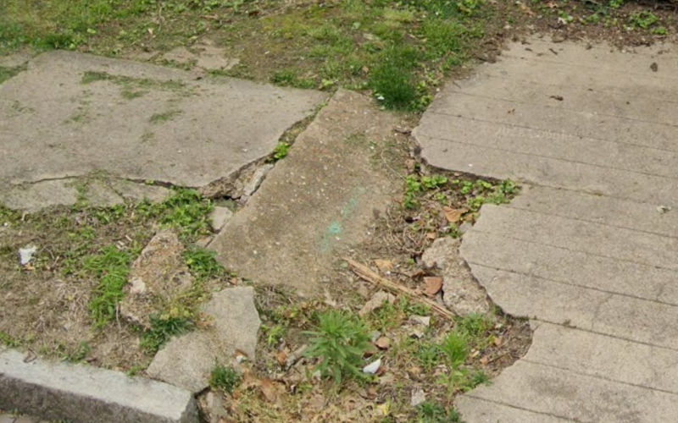
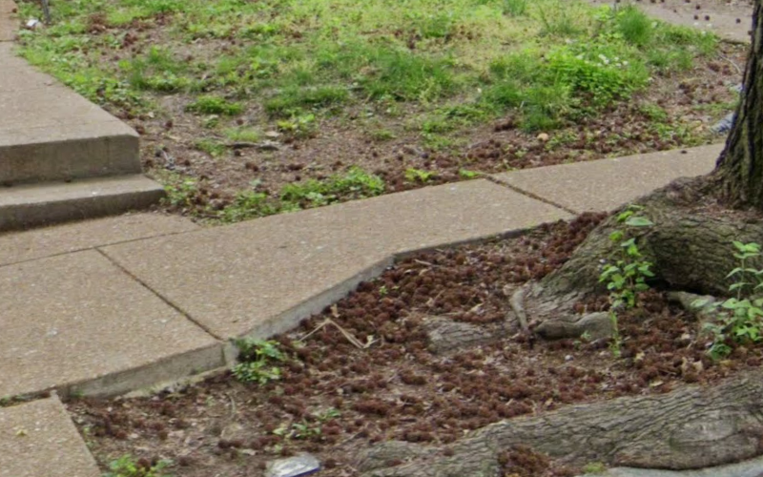
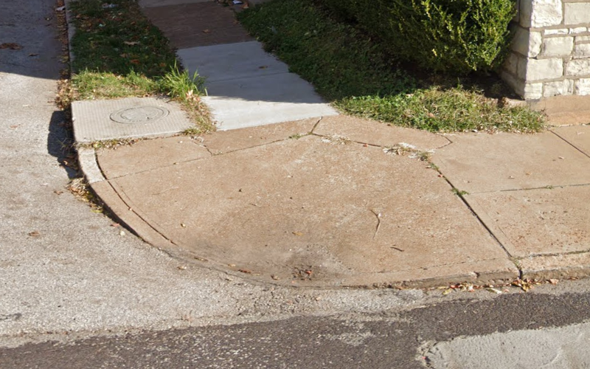
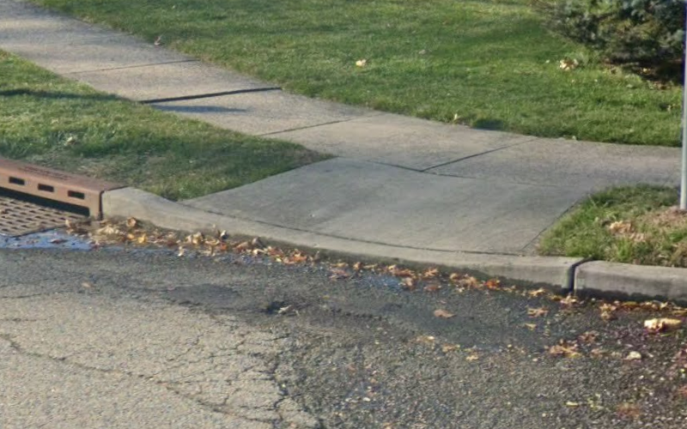
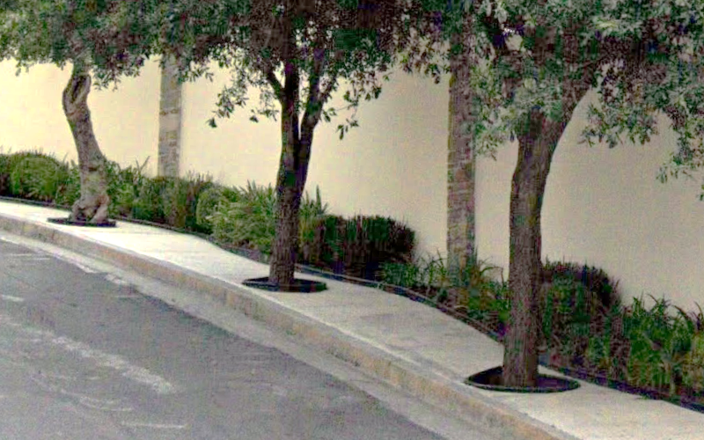
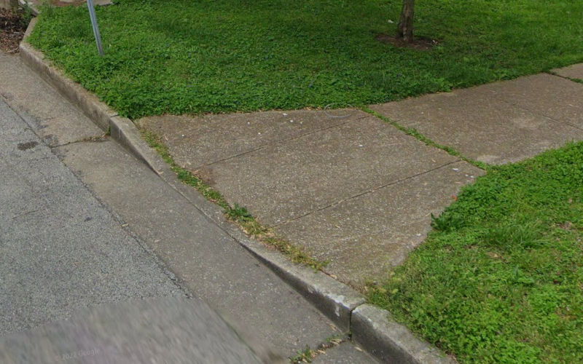
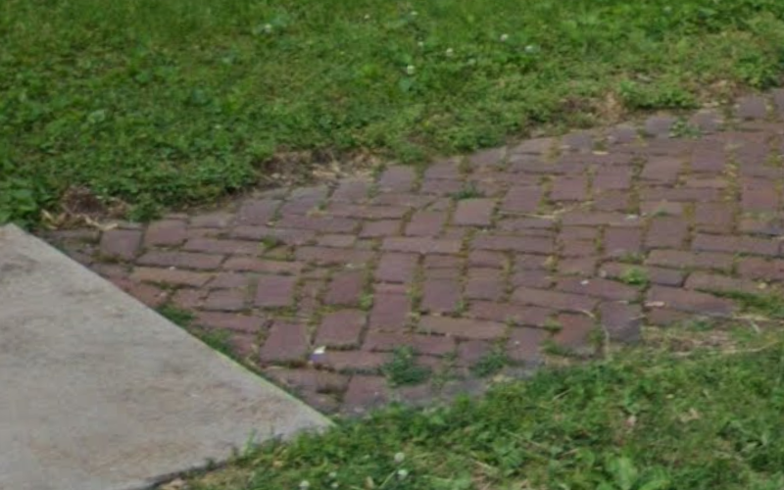
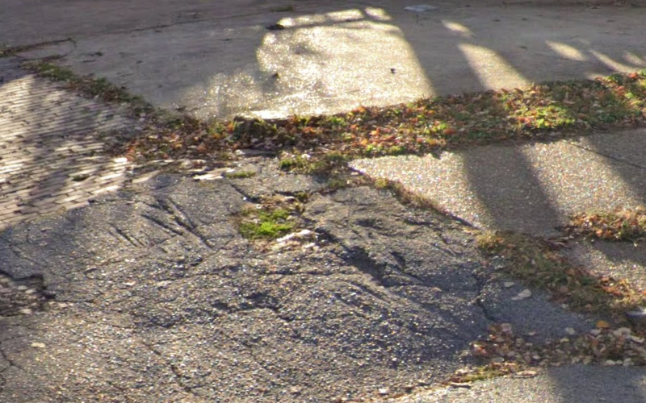
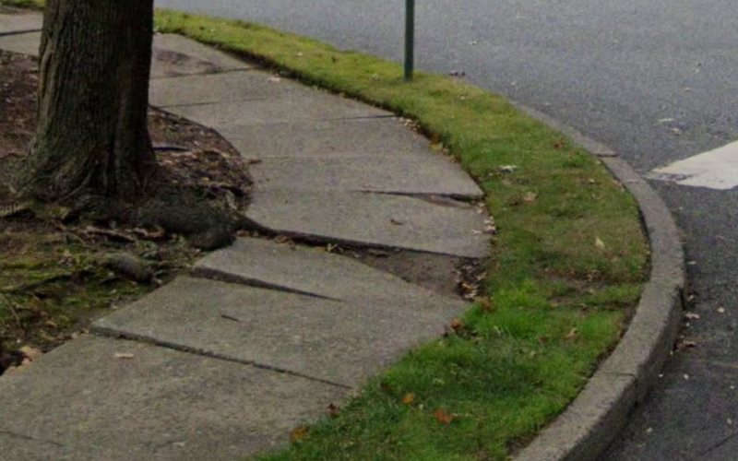
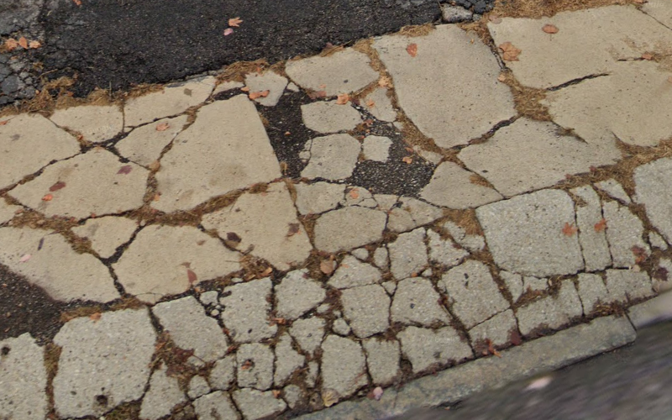
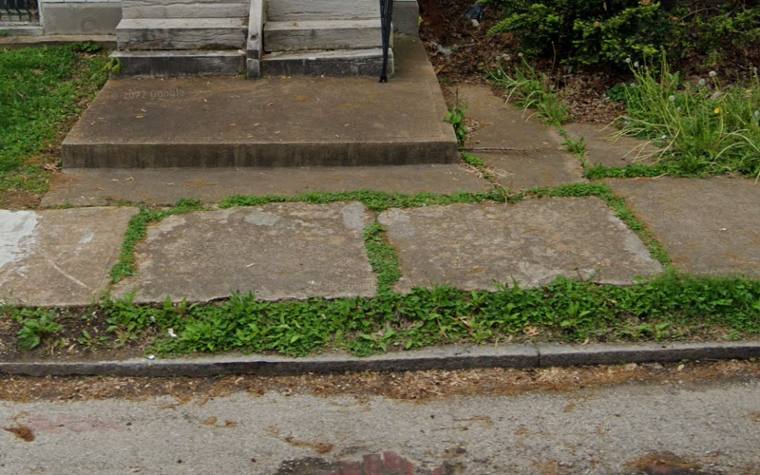
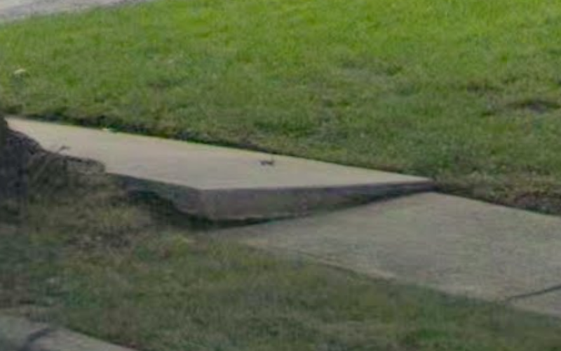
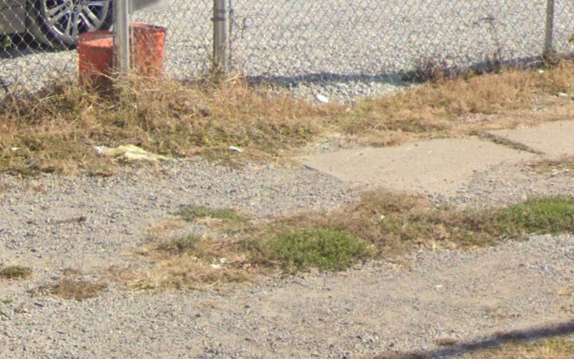
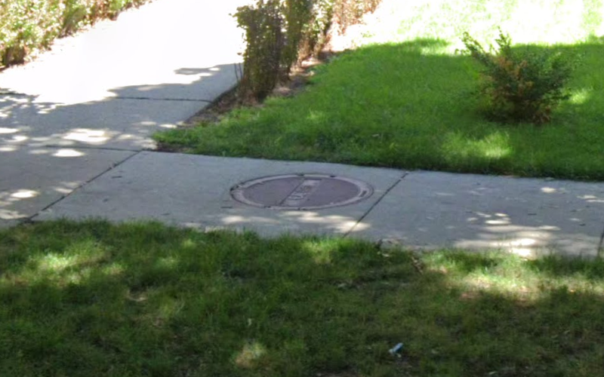
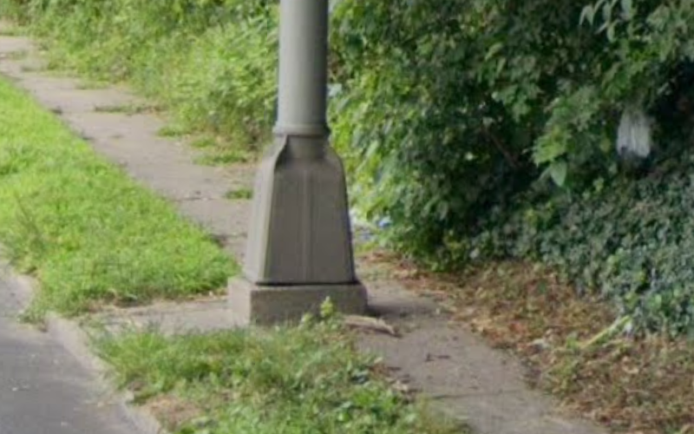
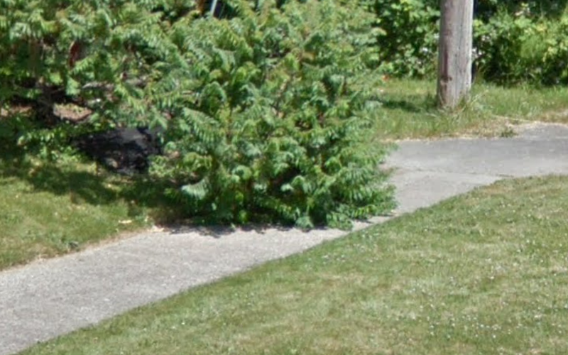
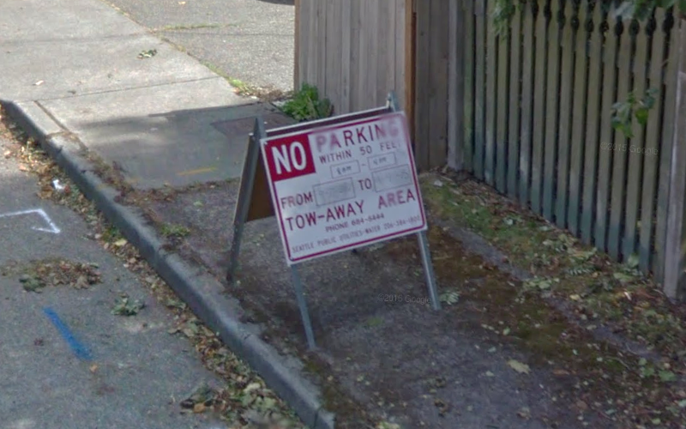
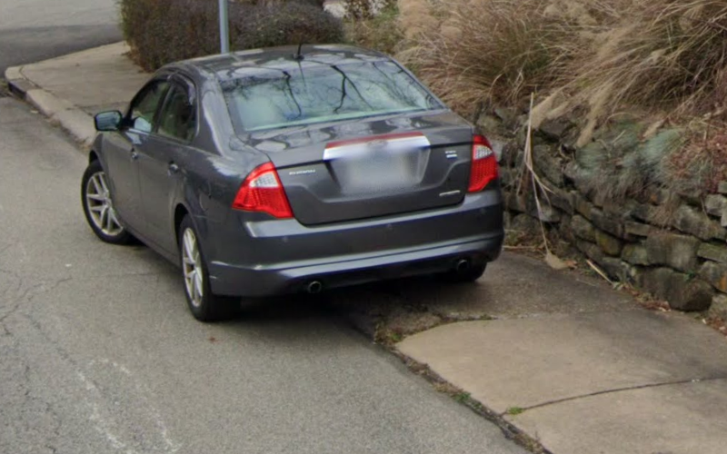
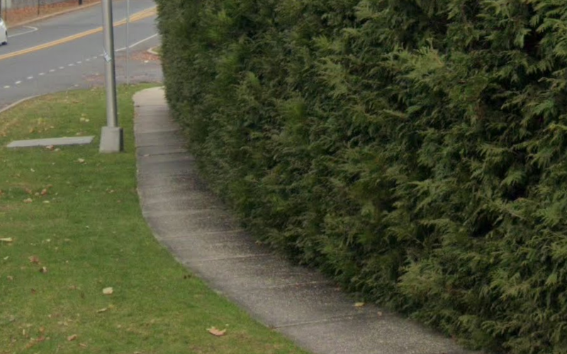
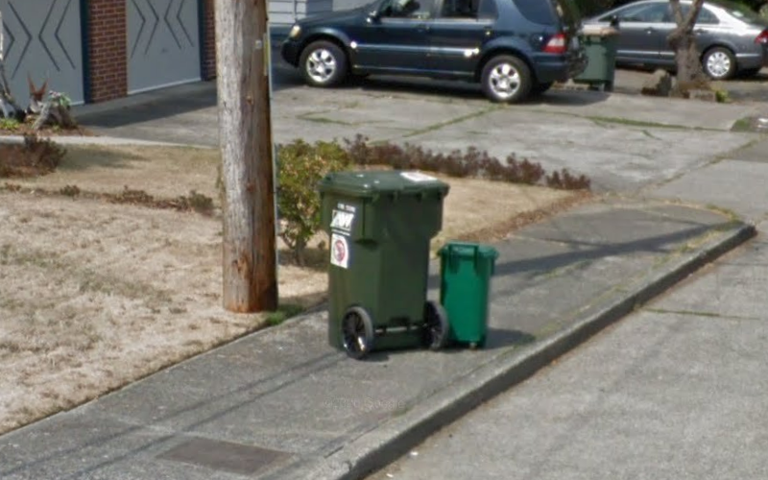
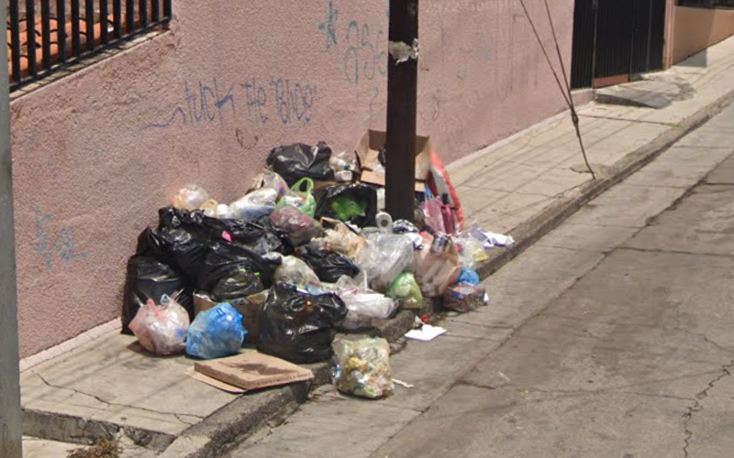
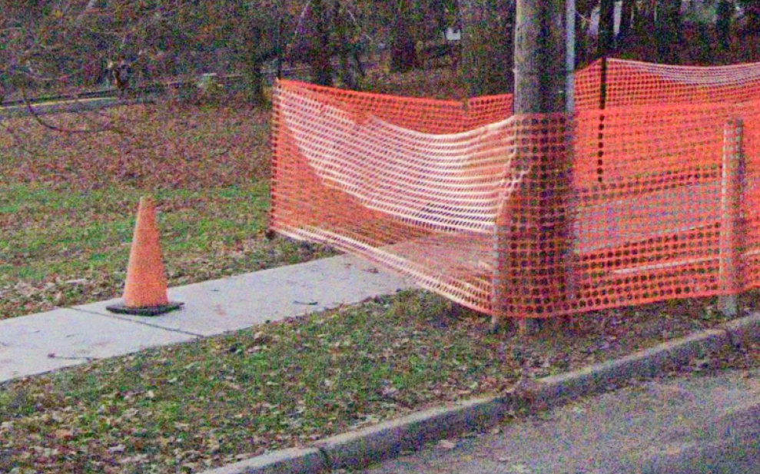
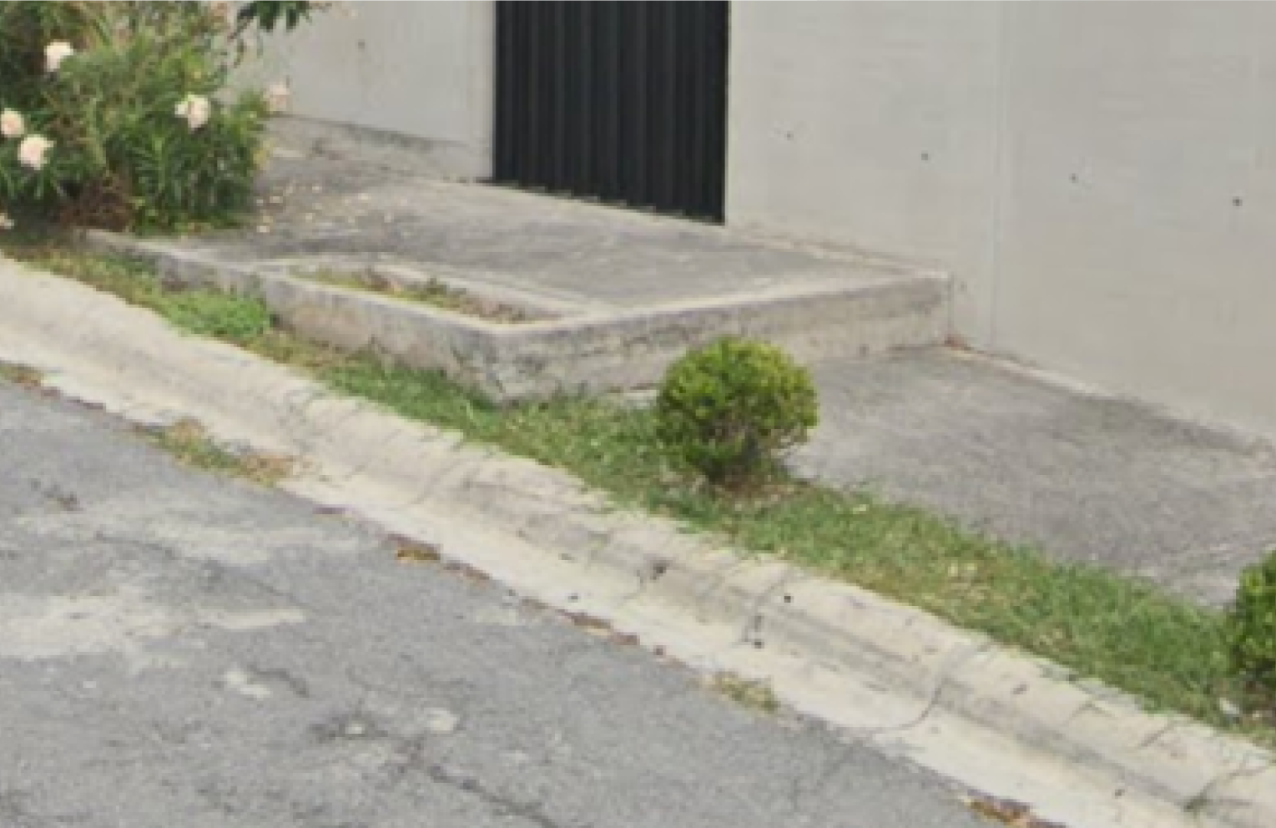
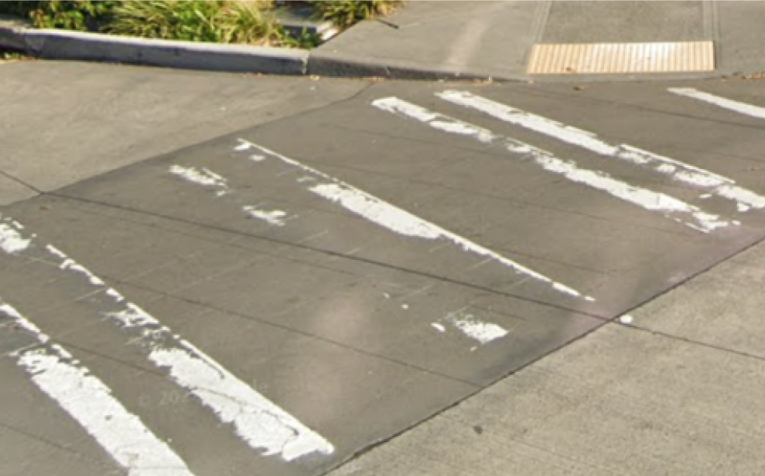
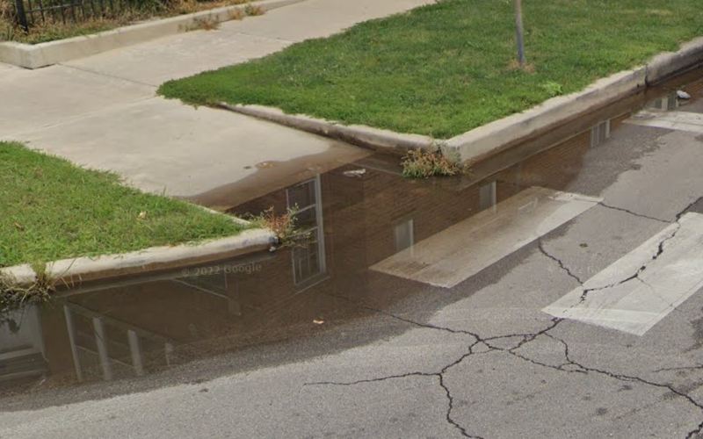
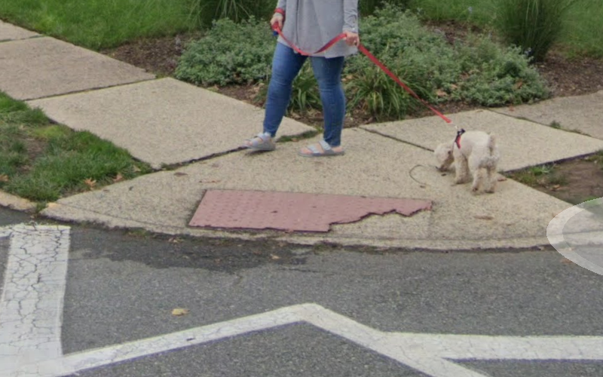
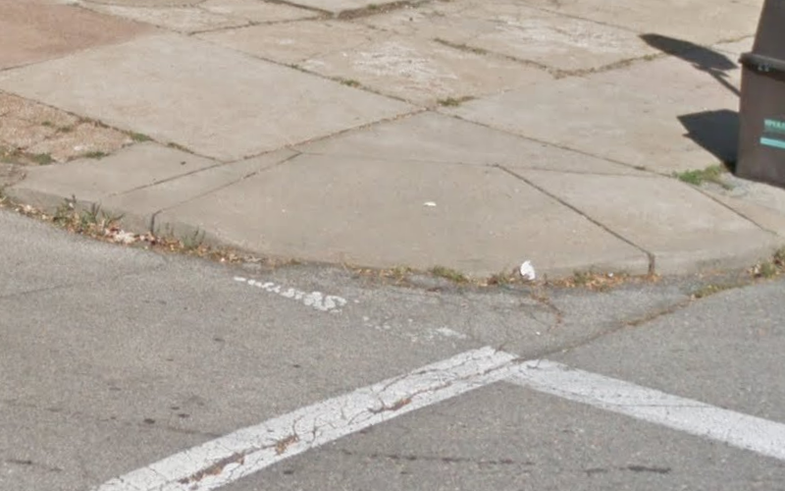
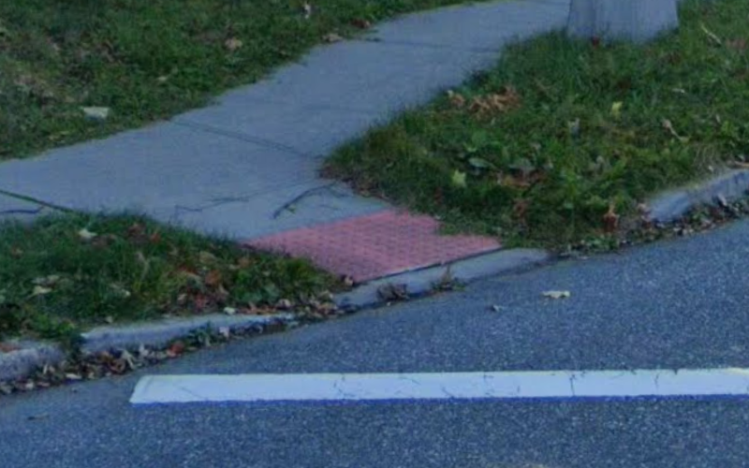
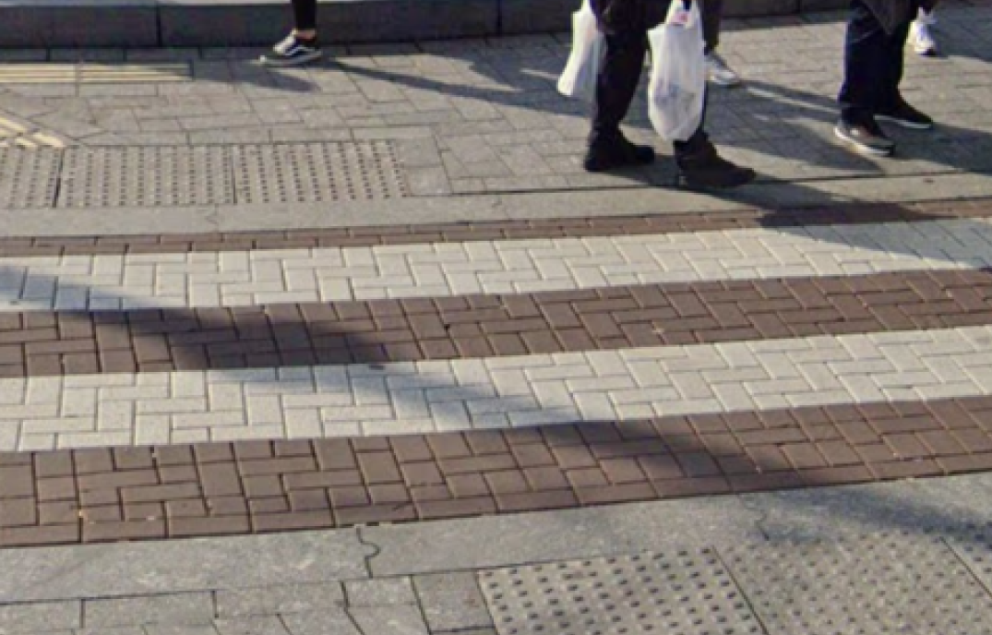
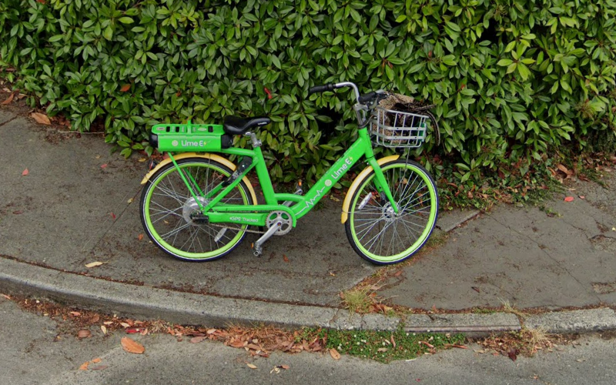
1 Million Labels!
Very broken
Narrow
Not enough landing space
Not level with street
Tree
Missing tactile warning
Brick/cobblestone
Bumpy
Uneven/slanted
Cracks
Grass
Height difference (uplift)
Sand/gravel
Utility panel
Pole
Vegetation
Sign
Parked car
Narrow
Trash/recycling cans
Litter/garbage
Construction
Height difference
Paint fading
Pooled water
Surface problem
Points into traffic
Narrow
Brick/cobblestone crosswalk
Parked Bike

Slide 2
1 Million Labels!
Very broken
Narrow
Not enough landing space
Not level with street
Tree
Missing tactile warning
Brick/cobblestone
Bumpy
Uneven/slanted
Cracks
Grass
Height difference (uplift)
Sand/gravel
Utility panel
Pole
Vegetation
Sign
Parked car
Narrow
Trash/recycling cans
Litter/garbage
Construction
Height difference
Paint fading
Pooled water
Surface problem
Points into traffic
Narrow
Brick/cobblestone crosswalk
Parked Bike

Slide 3
MILESTONE REACHED
Map and assess every sidewalk in the world through AI-powered crowdsourcing

Slide 4
MILESTONE REACHED
Map and assess every sidewalk in the world through AI-powered crowdsourcing

Slide 5
Very broken
Narrow
Not enough landing space
Height difference (uplift)
Tree
Missing tactile warning
MILESTONE REACHED
Brick/cobblestone
Bumpy
Uneven/slanted
Cracks
Grass
Not level with street
Sand/gravel
Parked bike on sidewalk
Pole
Overgrown Vegetation
Sign
Construction
Narrow
Trash/recycling cans
Litter/garbage
Parked car on sidewalk
Stairs
Paint fading
Map and assess every sidewalk in the world through AI-powered crowdsourcing
Pooled water
Surface problem
Points into traffic
Narrow
Brick/cobblestone crosswalk
Utility panel

Slide 6

1 Million Labels!
Very broken
Narrow
Not enough landing space
Height difference (uplift)
Tree
Missing tactile warning
Brick/cobblestone
Bumpy
Uneven/slanted
Cracks
Grass
Not level with street
Sand/gravel
Parked bike on sidewalk
Pole
Overgrown Vegetation
Sign
Construction
Narrow
Trash/recycling cans
Litter/garbage
Parked car on sidewalk
Stairs
Paint fading
Pooled water
Surface problem
Points into traffic
Narrow
Brick/cobblestone crosswalk
Utility panel

Slide 7
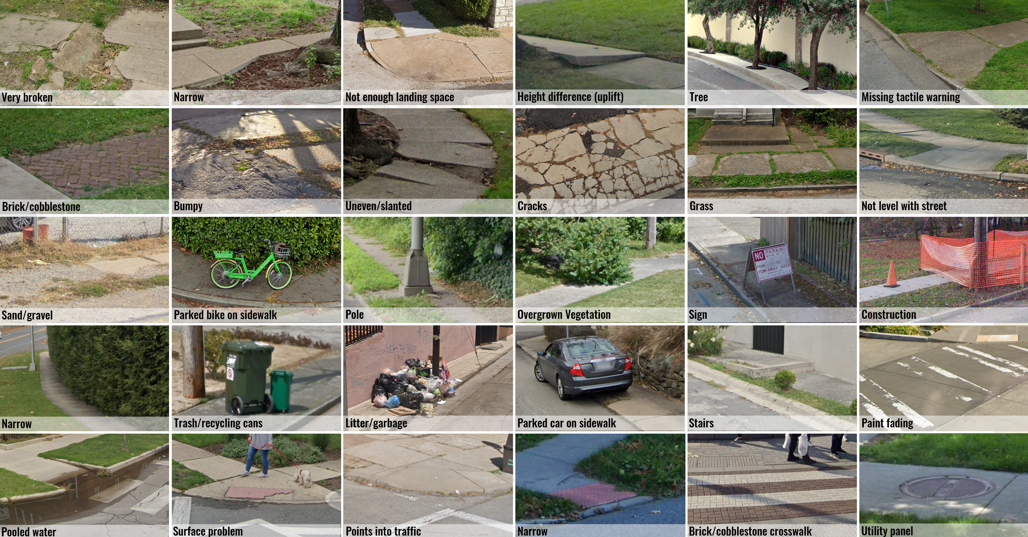
1 Million Labels!
Very broken
Narrow
Not enough landing space
Height difference (uplift)
Tree
Missing tactile warning
Brick/cobblestone
Bumpy
Uneven/slanted
Cracks
Grass
Not level with street
Sand/gravel
Parked bike on sidewalk
Pole
Overgrown Vegetation
Sign
Construction
Narrow
Trash/recycling cans
Litter/garbage
Parked car on sidewalk
Stairs
Paint fading
Pooled water
Surface problem
Points into traffic
Narrow
Brick/cobblestone crosswalk
Utility panel

Slide 8

1 Million Labels!
https://huggingface.co/projectsidewalk
Very broken
Narrow
Not enough landing space
Height difference (uplift)
Tree
Missing tactile warning
Brick/cobblestone
Bumpy
Uneven/slanted
Cracks
Grass
Not level with street
Sand/gravel
Parked bike on sidewalk
Pole
Overgrown Vegetation
Sign
Construction
Narrow
Trash/recycling cans
Litter/garbage
Parked car on sidewalk
Stairs
Paint fading
Pooled water
Surface problem
Points into traffic
Narrow
Brick/cobblestone crosswalk
Utility panel

Slide 9
1 Million Labels!
Very broken
Narrow
Not enough landing space
Height difference (uplift)
Tree
Missing tactile warning
Brick/cobblestone
Bumpy
Uneven/slanted
Cracks
Grass
Not level with street
Sand/gravel
Parked bike on sidewalk
Pole
Overgrown Vegetation
Sign
Construction
Narrow
Trash/recycling cans
Litter/garbage
Parked car on sidewalk
Stairs
Paint fading
Pooled water
Surface problem
Points into traffic
Narrow
Brick/cobblestone crosswalk
Utility panel

Slide 10
Milestone Reached: Project Sidewalk Accessibility Labels
Milestone Reached:1 Million Labels!
Very broken
Narrow
Not enough landing space
Not level with street
Tree
Missing tactile warning
Brick/cobblestone
Bumpy
Uneven/slanted
Cracks
Grass
Height difference (uplift)
Sand/gravel
Utility panel
Pole
Vegetation
Sign
Parked car
Narrow
Trash/recycling cans
Litter/garbage
Construction
Height difference
Paint fading
Pooled water
Surface problem
Points into traffic
Narrow
Brick/cobblestone crosswalk
Parked Bike

Slide 11
1 Million Labels!
Very broken
Narrow
Not enough landing space
Not level with street
Tree
Missing tactile warning
Brick/cobblestone
Bumpy
Uneven/slanted
Cracks
Grass
Height difference (uplift)
Sand/gravel
Utility panel
Pole
Vegetation
Sign
Parked car
Narrow
Trash/recycling cans
Litter/garbage
Construction
Height difference
Paint fading
Pooled water
Surface problem
Points into traffic
Narrow
Brick/cobblestone crosswalk
Parked Bike

Slide 12
1 Million Labels!
Very broken
Narrow
Not enough landing space
Not level with street
Tree
Missing tactile warning
Brick/cobblestone
Bumpy
Uneven/slanted
Cracks
Grass
Height difference (uplift)
Sand/gravel
Utility panel
Pole
Vegetation
Sign
Parked car
Narrow
Trash/recycling cans
Litter/garbage
Construction
Height difference
Paint fading
Pooled water
Surface problem
Points into traffic
Narrow
Brick/cobblestone crosswalk
Parked Bike

Slide 13


Slide 14

Notes:
https://pixabay.com/gifs/congratulations-party-confetti-7600/

Slide 15
1 Million Labels!
Very broken
Narrow
Not enough landing space
Not level with street
Tree
Missing tactile warning
Brick/cobblestone
Bumpy
Uneven/slanted
Cracks
Grass
Height difference (uplift)
Sand/gravel
Utility panel
Pole
Vegetation
Sign
Parked car
Narrow
Trash/recycling cans
Litter/garbage
Construction
Height difference
Paint fading
Pooled water
Surface problem
Points into traffic
Narrow
Brick/cobblestone crosswalk
Parked Bike

Slide 16
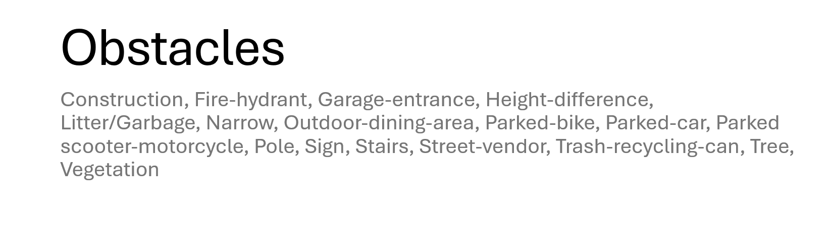
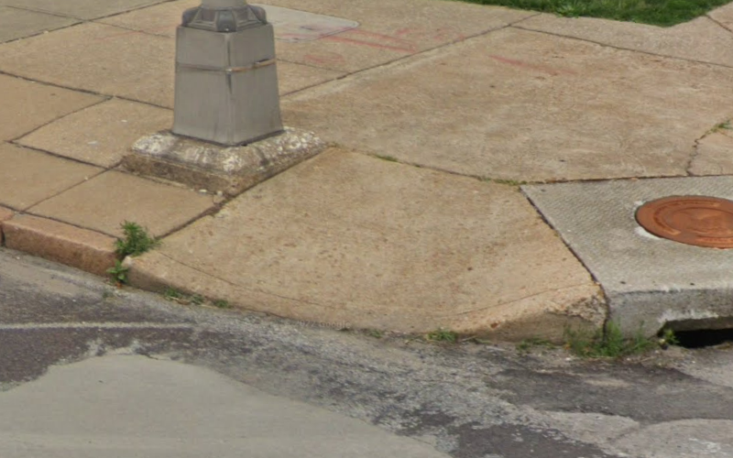
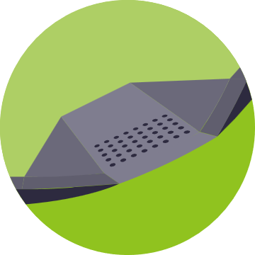
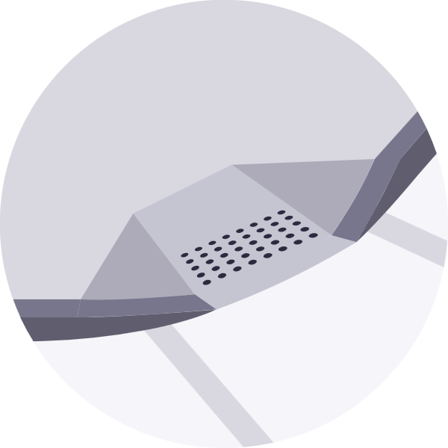


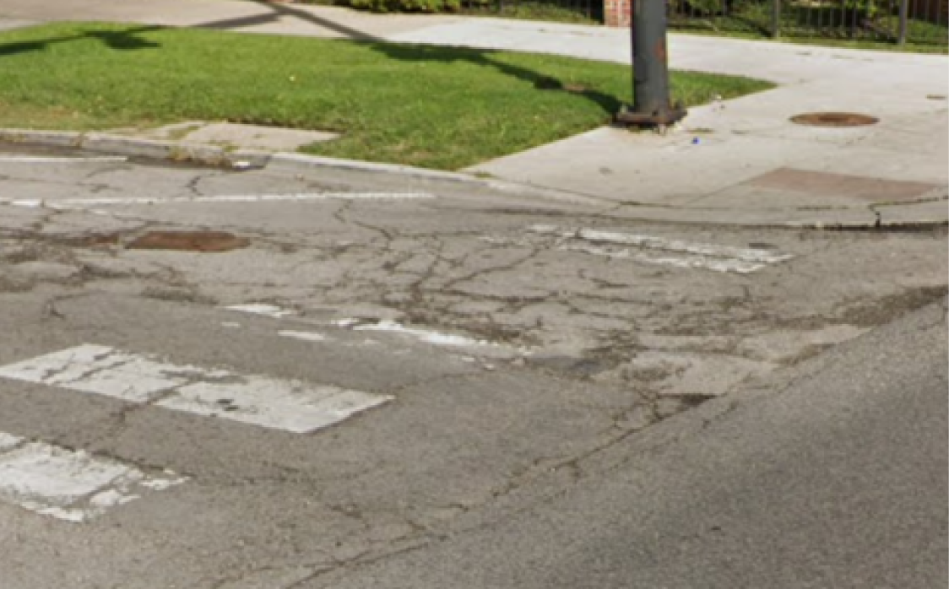
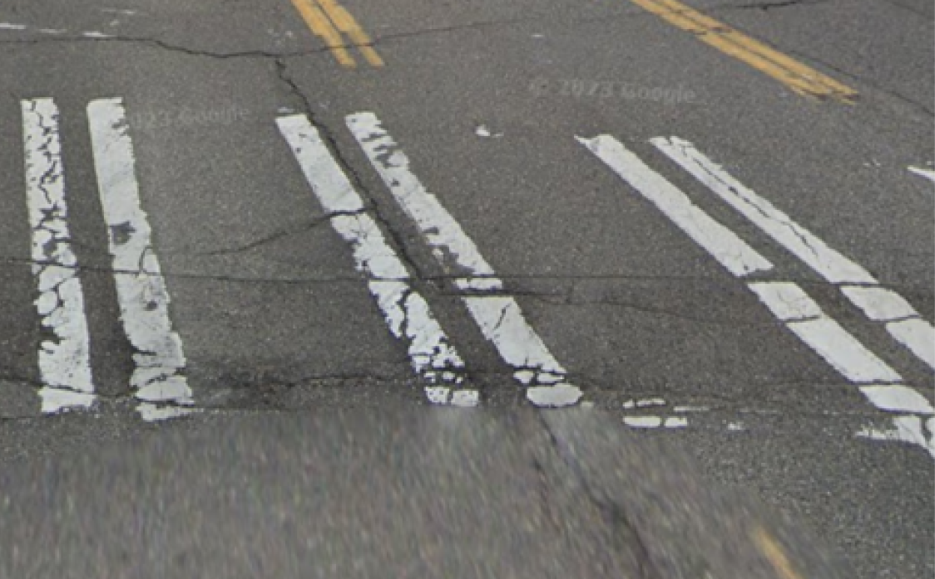

Narrow
Points into traffic
Not enough landing space
Not level with street
Steep
Missing tactile warning
Pooled water
Surface problem
Brick/cobblestone
Bumpy
Uneven/slanted
Cracks
Grass
Height difference (uplift)
Very broken
Narrow
Sand/gravel
Utility panel
Pole
Vegetation
Sign
Parked car
Parked Bike
Tree
Narrow
Trash/recycling cans
Litter/garbage
Construction
Height difference
Paint fading
Brick/cobblestone
Bumpy
Cracks
Curb Ramp conditions (N=8)
Surface Problem conditions (N=10)
Obstacle conditions (N=11)
Crosswalk conditions (N=4)
Notes:
Jon working for the CR

Slide 17
Very broken
Narrow
Not enough landing space
Not level with street
Steep
Missing tactile warning
Brick/cobblestone
Bumpy
Uneven/slanted
Cracks
Grass
Height difference (uplift)
Sand/gravel
Utility panel
Pole
Vegetation
Sign
Parked car
Tree
Narrow
Trash/recycling cans
Litter/garbage
Construction
Height difference
Paint fading
Bumpy
Cracks
Pooled water
Surface problem
Points into traffic
Narrow
Brick/cobblestone
Parked Bike
Notes:
Jon working for the CR

